Slide 1

DensePose: Dense Human Pose Estimation In The Wild
arXiv:1802.00434 [cs.CV]
Presented by
P.Jirayu, Ahmad

Slide 2
Content
Problem & Purpose
Theory & Resource
Methodology
How to proceed the project

Slide 3
Problem
We can understand this task as involving several other problems, such as object detection, pose estimation, part and instance segmentation either as special cases or prerequisites. Addressing this task has applications in problems that require going beyond plain landmark localization, such as graphics, augmented reality, or human-computer interaction, and could also be a steppingstone towards general 3D-based object understanding.

Slide 4
Purpose
Firstly, as described in Sec. 2, we introduce the first manually-collected ground truth dataset for the task, by gathering dense correspondences between the SMPL model.
Secondly, as described in Sec. 3, we use the resulting dataset to train CNN-based systems that deliver dense correspondence ‘in the wild’, by regressing body surface coordinates at any image pixel.
Thirdly, we explore different ways of exploiting our constructed ground truth information. Our supervision signal is defined over a randomly chosen subset of image pixels per training sample. We use these sparse correspondences to train a ‘teacher’ network that can ‘inpaint’ the supervision signal in the rest of the image domain.

Slide 5
Purpose
This work aims at pushing further the envelope of human understanding in images by establishing dense correspondences from a 2D image to a 3D, surface-based representation of the human body
While these works are aiming at general categories, our work is focused on arguably the most important visual category, humans. For humans one can simplify the task by exploiting parametric deformable surface models, the Skinned Multi-Person Linear (SMPL) model.

Slide 6
Theory: Annotation System
The human annotators establish a dense correspondence between images and a 3D surface model.
Segment the image to 25 semantic regions
sample every body part with a set of roughly equidistant points (Maximum 14 points for each part)
Each part is parameterized into UV coordinates

Slide 7

Theory: Accuracy of human annotators
Normally, multiple annotators annotate the same landmark and then the variance is calculated
In this case, the authors had access to true mesh coordinates for some images and asked the annotators to annotate these images
geodesic distance between the correct surface point was used, and the point estimated by human annotators

Slide 8
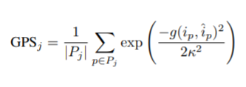
Theory: Evaluation Metrics
The authors have introduced geodesic point similarity (GPS) as a correspondence matching score

Slide 9
Theory: RCNN
The authors have introduced geodesic point similarity (GPS) as a correspondence matching score

Slide 10
Resource
I would recommend the following pre-requisites in this order:
R-CNN, Fast R-CNN, Faster R-CNN, and Mask R-CNN
DensePose-COCO Dataset
Computation resource (GTX 1080 GPU)

Slide 11
Methodology: Learning Dense Human Pose Estimation Fully-convolutional dense pose regression
The architecture consists of using a fully convolutional network ( FCN ) that combines classification and regression tasks
classify a pixel as belonging to either background or one among several region parts which provide a coarse estimate of surface coordinates
a regression system indicates the exact coordinates of the pixel within the part

Slide 12
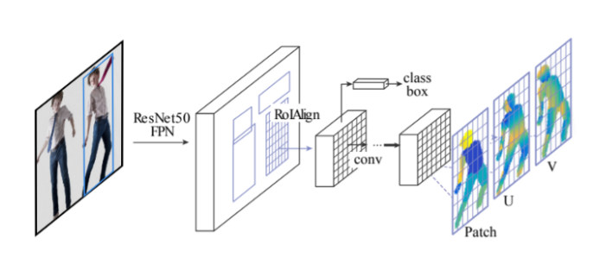
Learning Dense Human Pose Estimation Region based dense pose regression
Using an FCN is easier to code and train but expecting one network to do part segmentation and pixel localization, while at the same time requiring scale-invariance is just too much
Hence we can borrow heavily from Faster R-CNN and Mask R-CNN to improve the architecture as shown.

Slide 13
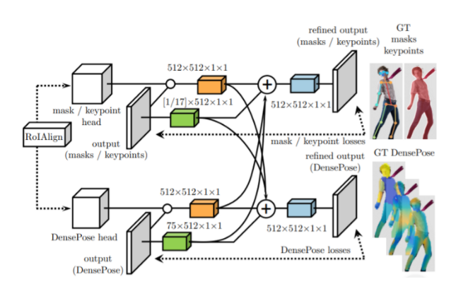
Learning Dense Human Pose Estimation Multi-task cascaded architectures
Cascading can improve performance both by providing context to the following stages, and also through the benefits of deep supervision

Slide 14
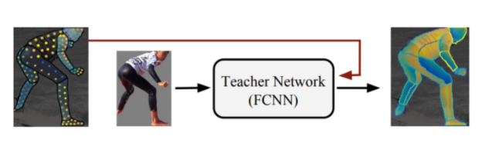
Learning Dense Human Pose Estimation Distillation-based ground-truth interpolation
The authors observed that we obtain substantially better results by “inpainting” the values of the supervision signal on positions that were not originally annotated

Slide 15
How to proceed the project
Setup the resource
Installation the library and project
Installing DensePose
Caffe 2
COCO API
Setting-up the COCO dataset
Using Detectron
Inference with Pretrained Models
Testing with Pretrained Models
Training a Model
Referred by https://github.com/facebookresearch/DensePose/blob/master/README.md https://github.com/facebookresearch/DensePose/blob/master/GETTING_STARTED.md

